Slide 1

PROJECT
REPORT
Promotional Performance Analysis of AtliQ Mart.
by
Siva Jetteboina

Slide 2
ABOUT THE PROJECT
This Project focuses on evaluating the Promotional Performance of AtliQ Mart’s Branded Products of Diwali 2023 and Sankranthi 2024.
AtliQ Mart Operating as a retail giant with over 50 Super Markets in the Southern Region of India, It Aims to leverage data – driven insights to Optimize Further Promotional Strategies.
By Analyzing Sales data and promotional activities, this study is helps to actionable insights to enhance AtliQ Market’s Marketing Strategies.

Slide 3

Ad – hoc
Requests
Evaluation
Stake holders of AtliQ Mart Have some Business Questions and they requiring SQL based report Generation

Slide 4
Data Sets
Used
dim_campaigns
dim_products
dim_stores
fact_events

Slide 5
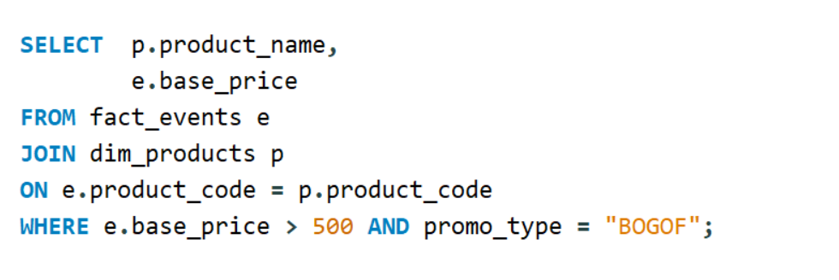
1
Provide a list of products with a base price greater than 500 and that are featured in Promo type of “BOGOF” (Buy One Get One Free) ?

Slide 6

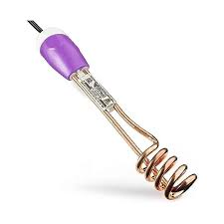
High Value BOGOF Products
1
2
AtliQ Double Bed Sheet
Base Price: 1190
AtliQ Immersion Rod
Base Price: 1020

Slide 7
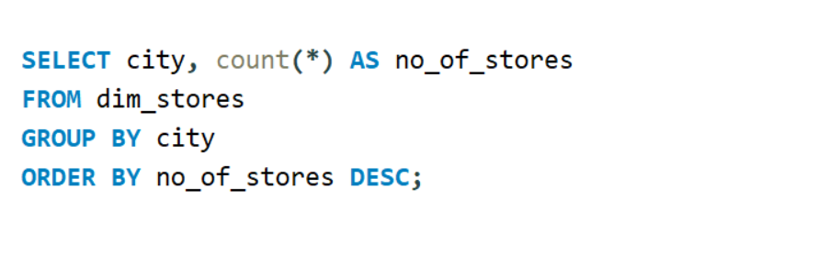
2
Generates a report that provides an overview of the no of stores in each city ?

Slide 8
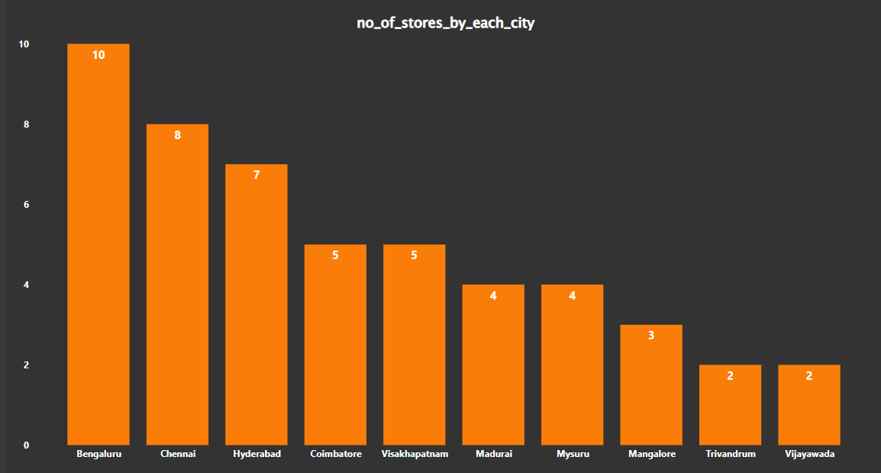
Store Distribution Analysis
Top 3 Cities Having More Stores
Bengaluru – 10 stores
Chennai – 8 stores
Hyderabad – 7 stores

Slide 9
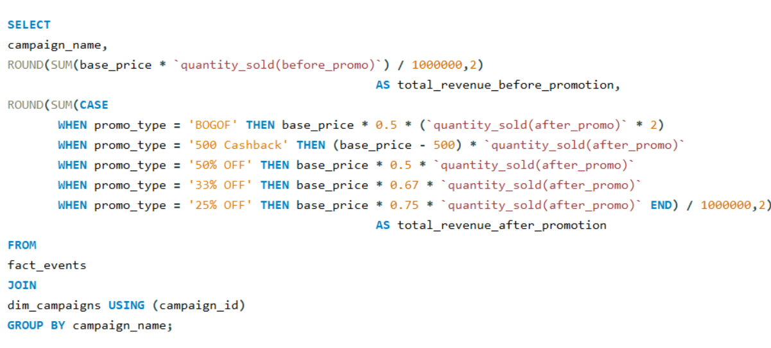
3
Generates a report that displays along with the total revenue generated Before and After Campaign ?

Slide 10
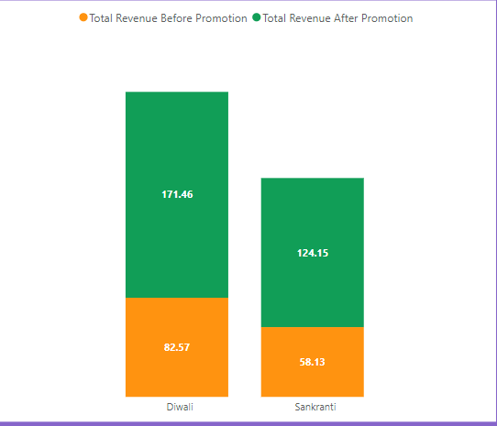
Total Revenue Analysis
*Revenue in Millions

Slide 11
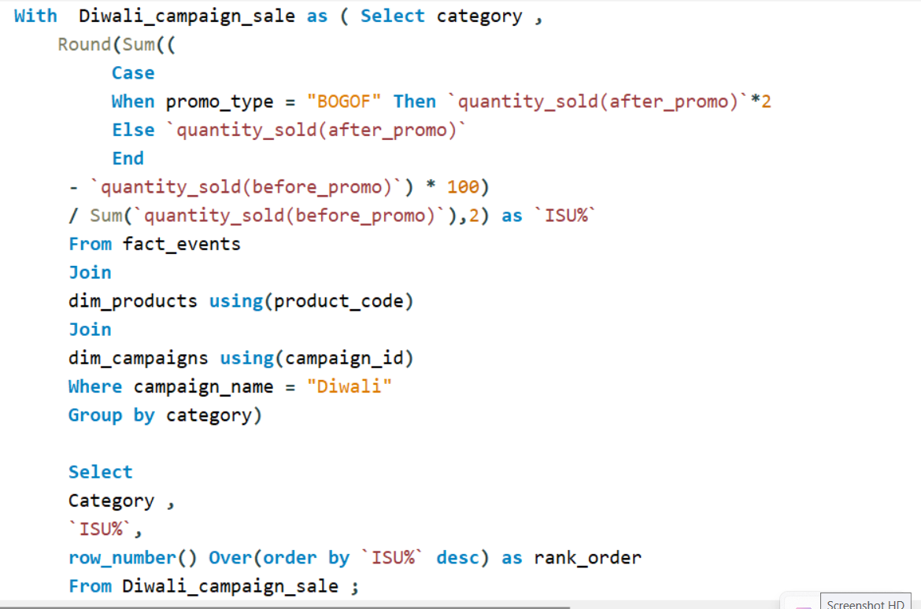
4
Produce report that calculates the incremental sold quantity (ISU%) for each category during the Diwali Campaign . Additionally Provide Rankings for the Categories based on their ISU % ?

Slide 12
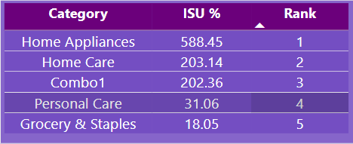
Category wise Diwali Campaign Performance
“Home Appliances” got 1st Rank with 588.45% of ISU.
“Home Care” got 2nd Rank with 203.14% of ISU.
“Combo 1” got 3rd Rank with 202.36% of ISU.

Slide 13
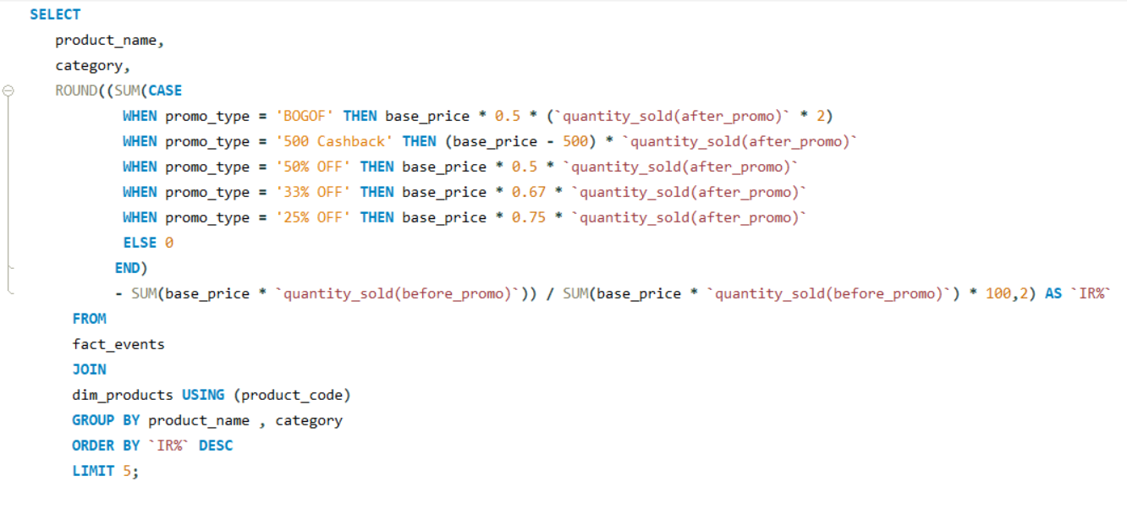
5
Create a report featuring the Top 5 Products, Ranked by Incremental Revenue Percentage , Across All Campaigns ?

Slide 14
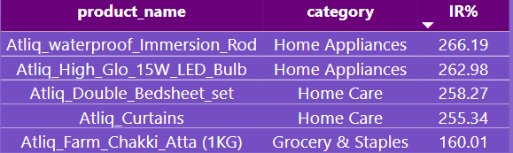
Top Performing Products By Incremental Revenue Percentage

